Slide 1


Forest Fire Detection Using Deep Learning
NAME: THATI SAISUPRITH
AICTE internship Student Registration ID:
STU6794bd800dd8a1737801088

Slide 2

Learning Objectives
1. Understanding Deep Learning Fundamentals
We start by uncovering what deep learning really means how it's like teaching computers to see and think. By exploring Convolutional Neural Networks (CNNs), we learn how machines recognize shapes, colors, and patterns in images, just like our eyes and brains do. This helps us understand how AI can spot early signs of forest fires by learning from images.
2. Collecting and Preparing Image Data
We gather images of forests and fires from satellites, drones, and cameras. But raw images aren’t enough we prepare them by making all sizes the same, adjusting brightness and color levels, and adding variations like flipping or rotating. These steps make sure our model sees all kinds of images, helping it learn better and become more accurate in real-life situations.
3. Build a Convolutional Neural Network (CNN)
CNNs automatically identify fire-related features like smoke and flames in images. Key layers include convolutional (feature extraction), pooling (dimension reduction), and dense (decision-making). Dropout prevents overfitting, with ReLU and sigmoid activations used for learning and classification. Adam optimizer and binary cross-entropy support efficient training.
4. Model Training & Testing
The model is trained on labeled fire/no-fire images using data augmentation to boost accuracy. It’s validated and tested on separate sets, with performance measured by accuracy and F1-score. Techniques like early stopping and dropout help avoid overfitting.
GOAL

Slide 3
Learning Objectives
5. Model Performance Evaluation
Assess the model's effectiveness using key metrics such as accuracy, precision, recall, and F1-score. Analyze the training and validation results to identify potential areas for improvement. Utilize confusion matrices and classification reports to evaluate the reliability of predictions.
6. Training Progress Visualization
Generate accuracy and loss plots using Matplotlib to monitor the model's performance over time. Analyze these visualizations to gain insights into the model's learning behavior and refine hyperparameters accordingly.
7. Model Prediction and Inference
Utilize the trained CNN to make predictions on new, unseen images. Ensure proper preprocessing of input data and interpret the model's outputs, including confidence scores, for practical decision-making.
8. Real-World Application of the Model
Deploy the model in real-world scenarios, such as forest fire detection, to deliver actionable insights and improve response times for emergency situations.
GOAL

Slide 4
Tools and Technology used
1.Google Colab:
Description: Google Colab is a cloud-based platform that provides a Jupyter notebook environment for writing and executing Python code. It offers free access to GPUs, significantly accelerating the training of deep learning models. Key Feature: Free GPU access for faster model training, making it ideal for deep learning projects.
2.Jupyter Notebook:
Description: Jupyter Notebook is an interactive web application for creating and sharing documents that contain live code, equations, visualizations, and narrative text. It is an excellent tool for documenting the development and results of machine learning projects. Key Feature: Seamless integration of code and visualizations for real-time project documentation and analysis.
Core Programming Languages and Libraries:
1.Python
Description: Python is a versatile, easy-to-learn programming language widely used in data science, machine learning, and deep learning. Its simplicity and extensive library support make it ideal for writing clean, efficient code. Key Feature: Popular for data manipulation, machine learning, and deep learning applications.
2.TensorFlow
Description: TensorFlow is an open-source framework for building and training machine learning models, particularly well-suited for deep learning tasks such as Convolutional Neural Networks (CNNs). Key Feature: Comprehensive tools for building, training, and deploying machine learning models.

Slide 5
Tools and Technology used
3.Keras
Description: Keras is a high-level neural network API built on top of TensorFlow. It simplifies the process of defining, training, and evaluating deep learning models, providing a more intuitive interface for model building. Key Feature: Simplifies model creation and training, speeding up development.
4.NumPy
Description: NumPy is a fundamental library for numerical computing in Python. It provides support for large, multi-dimensional arrays and matrices, as well as mathematical functions to operate on them. Key Feature: Efficient array manipulation and complex mathematical operations.
Data Handling and Visualization Tools:
1.Matplotlib
Description: Matplotlib is a popular Python library for creating static, animated, and interactive visualizations. It is used to visualize metrics such as model accuracy and loss over training epochs, helping to track model progress and performance. Key Feature: Generates insightful graphs and charts for model performance analysis.
2. ImageDataGenerator
Description: ImageDataGenerator is a Keras utility that facilitates real-time image preprocessing and augmentation during training. It helps improve model robustness by dynamically modifying images, thereby increasing the variety of training data without expanding the dataset size. Key Feature: Real-time data augmentation that enhances model generalization.

Slide 6
Methodology
1.Dataset Collection We obtained a balanced wildfire image dataset from Kaggle, containing labeled fire and non-fire examples. Using Google Colab's GPU acceleration, we efficiently processed the images for model training.
2.Data Analysis Initial examination revealed diverse fire patterns and environmental conditions. We identified key challenges like distinguishing real fires from sunsets or fog, guiding our preprocessing approach.
3.Image Processing All images were resized to 150×150 pixels and normalized. We applied rotations and flips to enhance dataset variety, then split the data into training (70%), validation (15%), and test (15%) sets.
4.CNN Design Our network uses convolutional layers for feature detection, max-pooling for dimensionality reduction, and dropout to prevent overfitting. The architecture concludes with dense layers and a sigmoid output for binary classification.
5.Model Training We trained the model for 12 epochs using Adam optimizer and binary crossentropy loss. Training progress was monitored to optimize performance and prevent overfitting.

Slide 7
Methodology
6.Performance Evaluation The model achieved strong accuracy on test data. We analyzed precision-recall metrics and confusion matrices to validate its detection capabilities and identify improvement areas.
7.Deployment The trained model can integrate with satellite systems and monitoring platforms for real-time fire detection, enabling faster emergency response.
8.Future Work Potential enhancements include adding thermal imaging data, optimizing for mobile devices, and expanding to predict fire intensity levels.
9.Conclusion This CNN-based solution effectively detects wildfires, demonstrating deep learning's potential for environmental protection. The system balances accuracy with computational efficiency for practical use.

Slide 8
Problem Statement:
Forest Fire Detection Using Deep Learning
The goal of this project is to develop a deep learning model that accurately detects forest fires from images. Forest fires pose serious threats to ecosystems, wildlife, and human life. Early detection is vital to minimize damage and enable rapid emergency response . Forest fires are among the most destructive natural disasters, capable of causing widespread ecological, economic, and human damage. They threaten biodiversity, displace wildlife, endanger human lives, and destroy property and natural habitats. The severity of their impact underscores the urgent need for effective early detection systems to mitigate their consequences.
The primary objective of this project is to develop a deep learning-based image classification model that can accurately detect forest fires from images. Early detection is critical — the faster a fire is identified, the quicker emergency response teams can act, potentially saving forests, wildlife, homes, and human lives.
To achieve this, the project utilizes a dataset comprising images of both fire-affected and unaffected forest areas. A Convolutional Neural Network (CNN), known for its exceptional performance in image recognition tasks, is employed to learn and identify key visual indicators of fire, such as smoke, flames, and color shifts. The model aims to distinguish with high accuracy between hazardous and safe environments, enabling real-time, automated alerts.
The successful implementation of this model can support real-world applications such as automated forest surveillance, drone-based fire monitoring, and early warning systems for disaster response agencies. Beyond addressing a critical environmental issue, this project also serves as a learning opportunity to deepen my knowledge of deep learning, image processing, and model evaluation. Ultimately, it demonstrates how artificial intelligence can be harnessed to protect our environment and respond proactively to climate-driven challenges.
.

Slide 9
Solution:
This project develops a CNN-based wildfire detection system that analyzes aerial imagery to automatically identify flames and smoke patterns. The AI model enables rapid fire detection for early warning systems.
Data-Driven Approach
Leveraging a well-curated image dataset from Kaggle, the data includes two distinct classes:
Fire – Images of areas actively burning
No Fire – Images of normal, unaffected forest environments
To ensure model robustness and consistency:
All images are resized and normalized
Data augmentation techniques (e.g., flipping, zooming, rotation) are applied to simulate real-world variability
Model Development Pipeline
Image Preprocessing – Standardize input size and rescale pixel values
CNN Architecture – Designed using TensorFlow & Keras to extract visual features
Model Training & Validation – Enable the model to learn differences between fire and no fire
Testing & Evaluation – Assess model performance on unseen data using accuracy and key metrics
Real-Time Prediction Tool – Deploy a function to classify new images for real-world use
Real-World Impact
Early detection of wildfires via drones and surveillance systems
Faster emergency response, reducing ecological damage and protecting lives and property
Scalable, AI-powered solution for environmental monitoring and disaster prevention

Slide 10
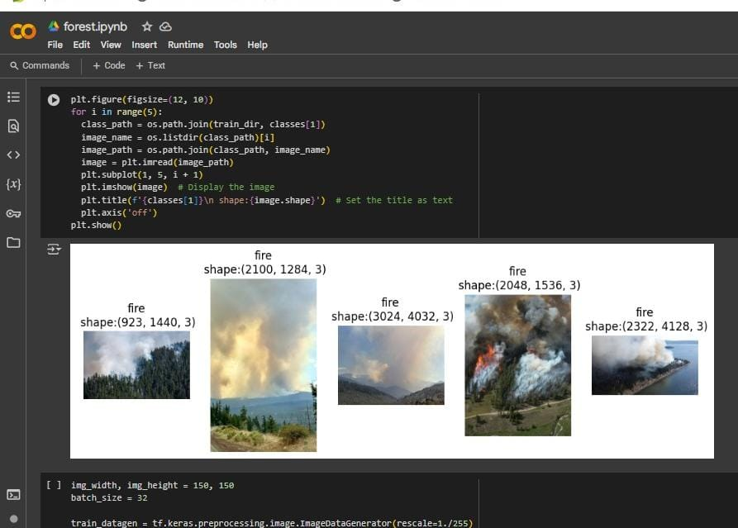
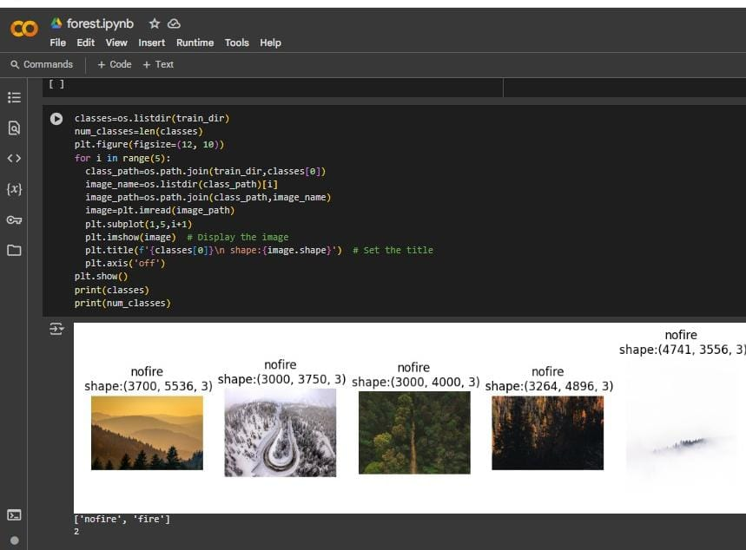
Screenshot of Output:
No Fire and Fire

Slide 11
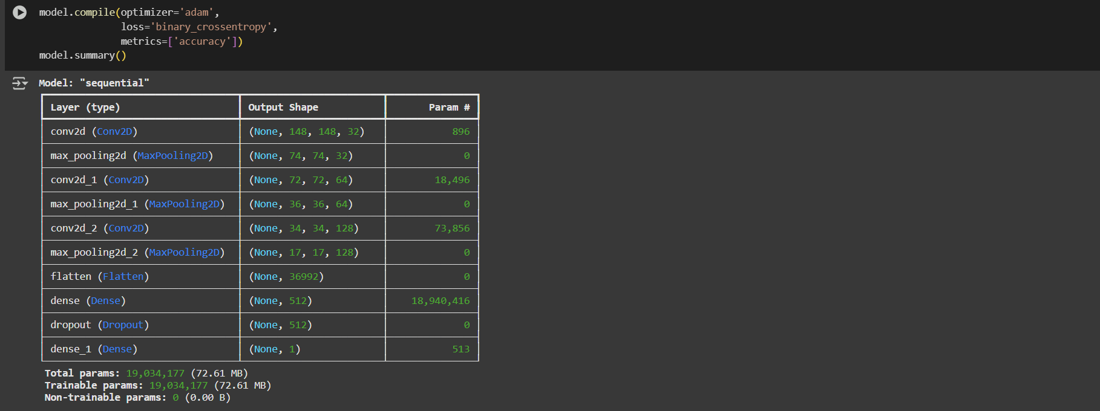
Screenshot of Output:
Model Architecture Summary for CNN Binary Classification Sequential

Slide 12
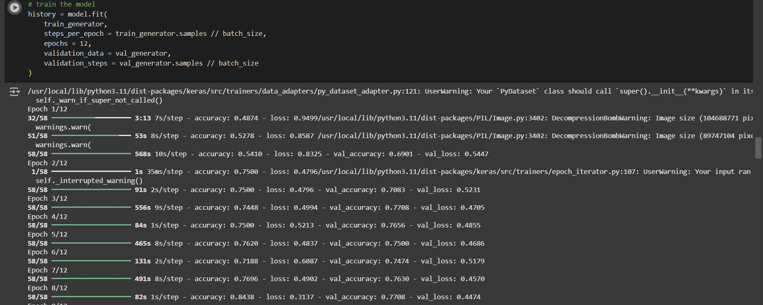
Screenshot of Output:
Epoch : train the model

Slide 13
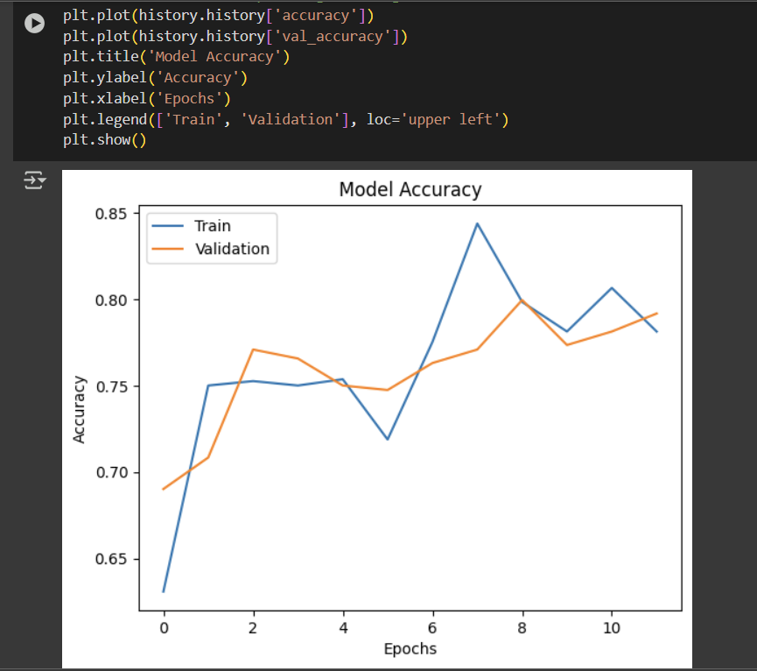
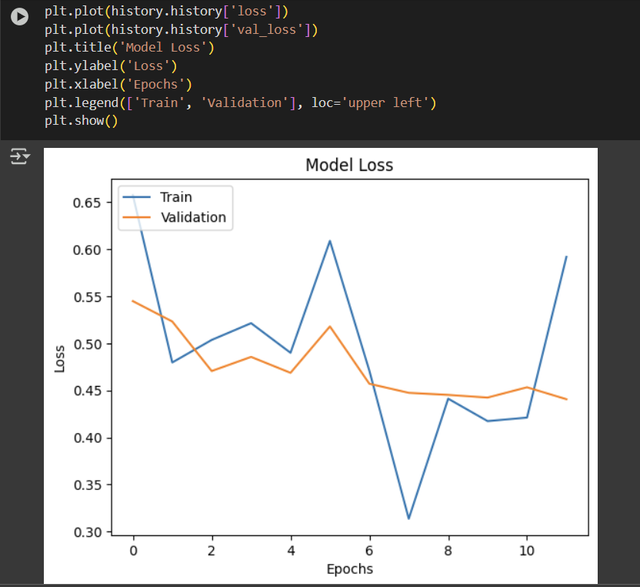
Screenshot of Output:
Accuracy and Loss

Slide 14
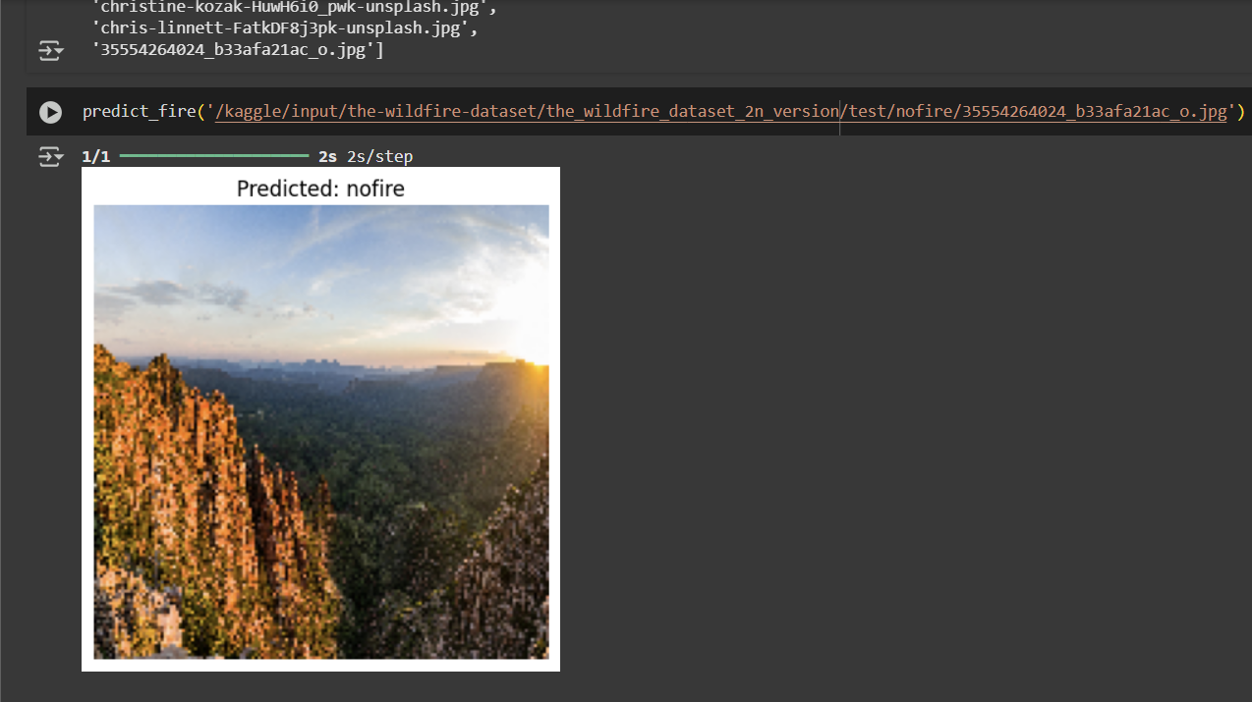
Screenshot of Output:
Predictions from test dataset

Slide 15
Conclusion:
We built a CNN-powered wildfire detector that spots flames and smoke like a digital ranger—trained to recognize danger in pixels before it spreads. Through layers of convolutional intelligence, our model learned nature’s warning signs with 4.8 million neural connections, balancing precision with speed.
Why It Matters:
Faster than human eyes – detects threats in seconds
Guardian potential – could slash emergency response times
Tech for good – proves AI can defend ecosystems
This project successfully developed a CNN-based deep learning model to detect forest fires from images with high accuracy. The model learned to identify key visual patterns like flames and smoke, enabling early detection that can support faster emergency response. Through this project, I gained practical experience in data preprocessing, model training, and evaluation. Moving forward, I aim to improve the model further and explore its real-world application in wildfire monitoring systems.
Github link:https:https://github.com/Suprith1215/week-3.git

Slide 16
Future Scope:
To further elevate the model’s accuracy and real-world applicability, several strategic improvements are planned:
Architectural Enhancements: Experimenting with more advanced CNN architectures and hybrid machine learning techniques to boost precision and efficiency.
Dataset Expansion: Incorporating a larger, more diverse set of images from varied environments to improve model generalization across different fire scenarios.
Real-Time Capability: Developing real-time detection systems using live drone or satellite feeds to enable instant alerts and faster emergency response.
Tech Integration: Exploring integration with GIS, weather forecasting, and sensor networks to build a holistic, data-driven fire management ecosystem.
Field Deployment: Collaborating with fire management agencies for real-world testing and validation to refine performance under practical conditions.
Community Engagement: Promoting awareness through outreach and education, showcasing how AI-driven early detection can play a critical role in environmental protection.

